Slide 1





TeenEagle Maths
Competition (TMC)
A new global challenge under the Teeneagle brand
Inspiring young problem solvers worldwide

Slide 2




TMC Categories & Grade Levels
TMC 1
TMC 2
TMC 3
Born in 2018 & 2019
Early Primary
Born in 2016 & 2017
Early Primary
Born in 2014 & 2015
Primary

Slide 3



TMC Categories & Grade Levels
TMC 4
TMC 5
TMC 6
Born in 2012 & 2013
Lower Secondary
Born in 2010 & 2011
Upper Secondary
Born in 2008 & 2009
Advanced

Slide 4

COMPETITION STRUCTURE
Practice & Learn
Qualify
Global Finals
Free Online Materials, Sample Exams and Zoom Club Classes
An international event with competitions, cultural activities and exciting trips
Online or Paper-based
30 Questions, 90 minutes
Six Levels (TMC 1–6) with age/grade alignment across curricula

Slide 5





08 November 2025
06 December 2025
17 January 2026
07 February 2026
07 March 2026
04 April 2026

Slide 6

The Qualification Exam
  Duration: 90 minutes
  Format: 30 multiple-choice questions
  Based on the TMC Curriculum
  Covers: Problem solving, Algebra, Geometry, Number Theory, Logic
  Only students who successfully pass this stage earn their place in the Global Finals.

Slide 7
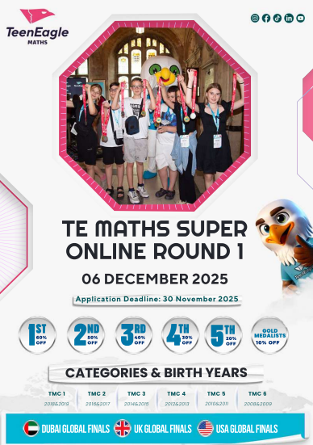
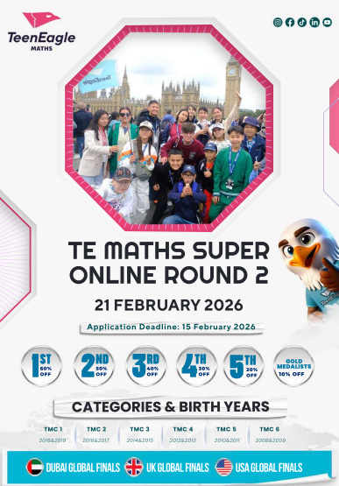

Slide 8




TeenEagle Maths Global Finals
Dubai
27 Mar-2 April 2026
London, UK
21-28 June 2026
United States
26 July- 1 Aug 2026
London, UK
2-9 August 2026

Slide 9

The Global Finals
3 Competitive Events --- 2 Medals --- 1 Overall Champion!
The Written Exam
Rapid Fire Round
Logical Minds Challenge
Format: 30 questions in 90 minutes
Focus: Quantitative and computational mathematics
Challenge Level: Progressive, testing accuracy, depth, and endurance
Format: Live, quick-response competition
Focus: Quantitative and computational mathematics under strict time pressure
Style: High-energy, interactive, and competitive
Format: 5 carefully designed challenges
Focus: Logical reasoning, analytical thinking, and pattern recognition
Goal: To test creativity and lateral thinking beyond pure computation

Slide 10

Awards &
Recognition
  Gold, Silver, Bronze & Honorable Mention medals
  Certificates for all participants
  Special awards for top international scorers
  Scholarship opportunities of up to £6,000 from our partner universities for Global Finals participants

Slide 11

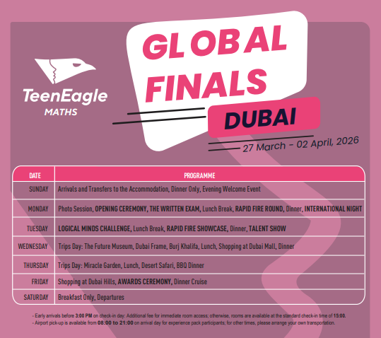

Slide 12
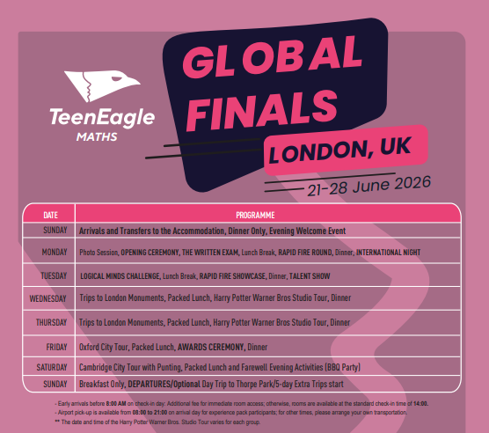
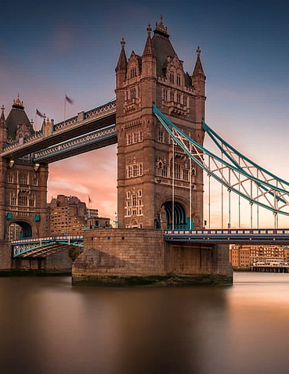

Slide 13
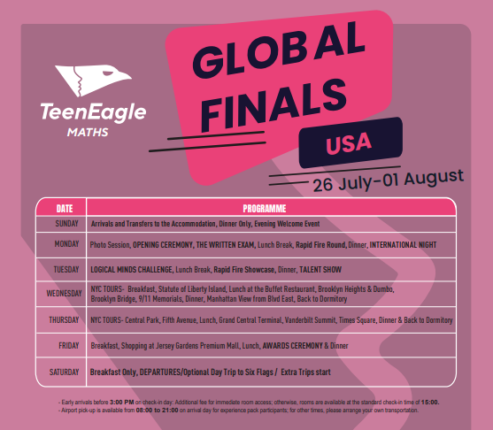



Slide 14


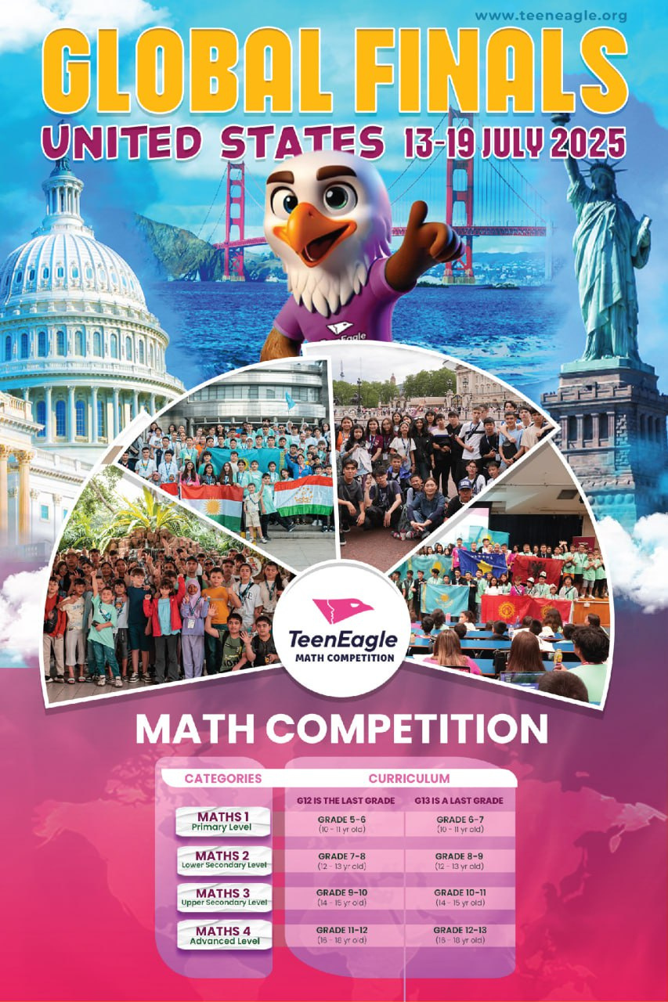

Benefits of TMC
Enhances critical thinking and mathematical skills
Builds confidence and global connections
Prepares students for advanced competitions and Olympiads
Provides international recognition

Slide 15


Why TeenEagle Maths?
Built on the success of the Teeneagle English competition
Expanding into Mathematics to challenge logic, reasoning & creativity
Aimed at students worldwide, from early primary to advanced level
Fostering global academic and cultural exchange

Slide 16

Join Us!
Registration via www.teeneagle.org
Open to schools & independent candidates
info@teeneagle.org
Think sharper. Aim higher.—discover the champion in you!

